Slide 1
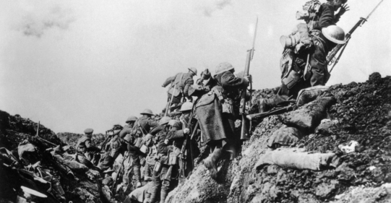
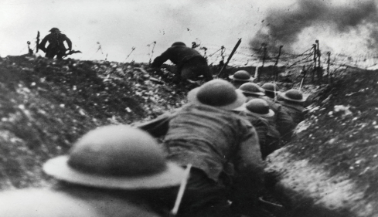
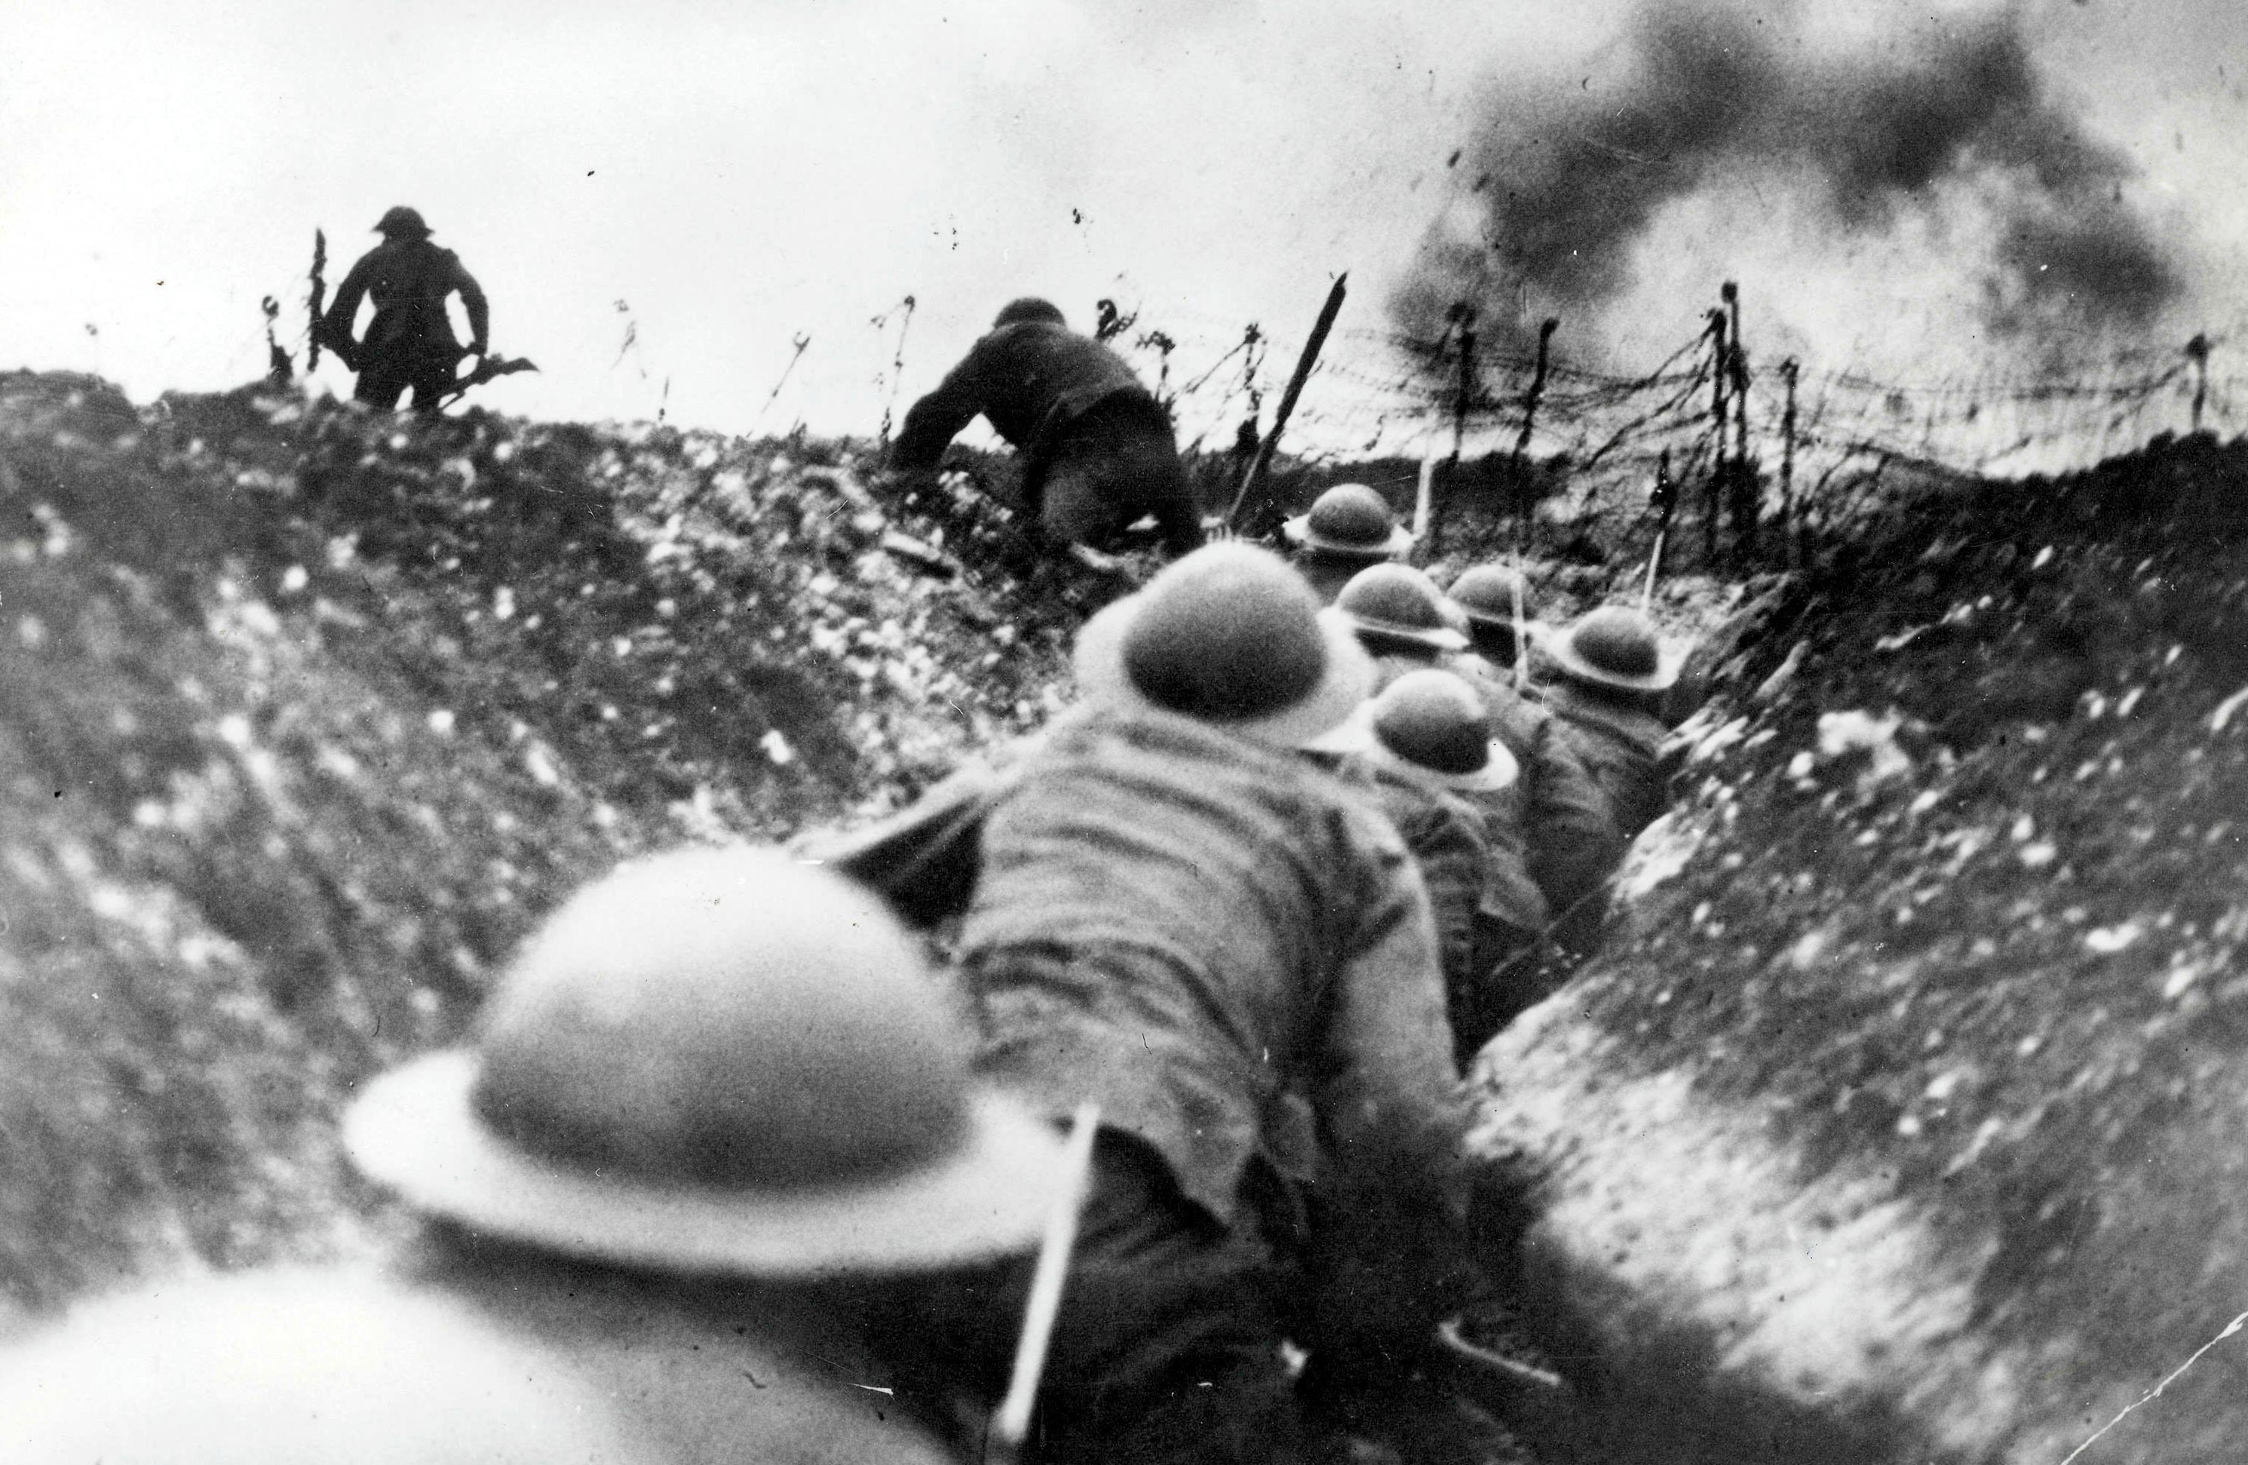
WORLD WAR I
All about the horrible horrendous world war one
This was a horrible event which started in
July 1914-November 1918

Slide 2
How did it start?
The assassination of Archduke Franz Ferdinand in Sarajevo on 28th June 1914, it triggered a chain of events that resulted in World War 1.After the killing the Hungarians started war on Serbia and the Russians sided with the Serbians. The first shot was in the start of the war by the Hungarians through there trenches. The trenches were horrible places with people drowning in mud and people dying because of the climate it was absolutely terrible place to be for the soldiers and why we pay respect to the soldiers who had to go fight in the trenches.

Slide 3
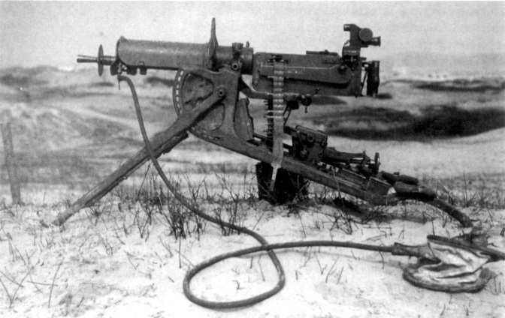
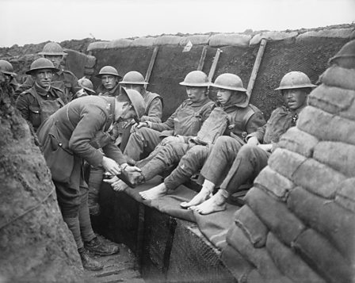
MAJOR BATTLES!
Battle of Cambrai 1917
Battle of Caporetto 1917
Battle of Passchendaele 1917
Battle of Verdon 1916
Battle of Jutland 1916
Battle of Gallipoli 1915-1916
Battle of First battle of Marne 1914
Battle of Tannenberg 1914

Slide 4
LIFE IN THE TRENCHES!
All I can say is life in the trenches is not where you want to be at he top of your list
Individuals spent only a few days a month in a front-line trench. Daily life here was a mixture of routine and boredom – sentry duty, kit and rifle inspections, and work assignments filling sandbags, repairing trenches, pumping out flooded sections, and digging latrines. Any free time was usually spent reading or writing letters or diaries, playing cards or trying to snatch a few moments of sleep . And when the day was freezing with the terenchal rain unfortunatly since the mud gets so churned up and gooey by the rain some soldiers drowned in the mud.

Slide 5
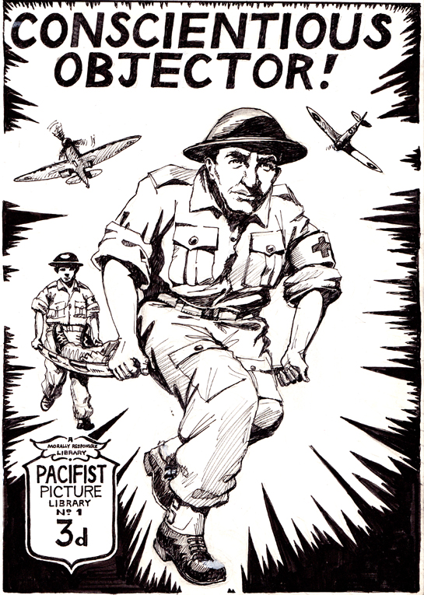
CONSCIENTIOUS IN THE WAR !
Soldiers were recruited when any body men over 18 had to go fight in the war. Sometimes people would lie about there age so they go fight in the war! The conscientious soldier is a person who has claimed the right to perform military service, so to make things for simple there the person where your gates are and when to fire and they tell you what to do and where it is.

Slide 6
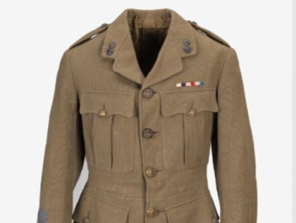
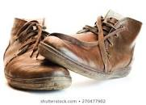
Weapons and clothing
Women during World War I typically wore head scarves, turbans, wedged-heal shoes (versus high heels), and the kangaroo cloak.and men would wear leather black boots with camouflauged clothing on there bodies with short hats.As for weapons people would use uzi’s,rifles,rifles,smg and aircraft they would send planes above the enemy’s light the bombs and drop the bombs onto there heads. They also use cannons and send out tanks to explode the enemy’s base or trenches so they can shoot them or just blow them up with the tanks.

Slide 7
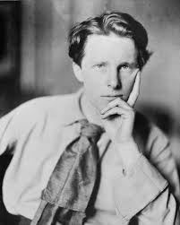
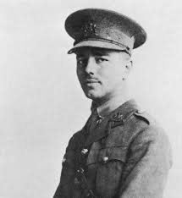
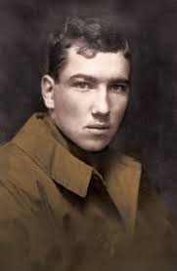
Famous poets!
Wilfred owen- anthem for doomed youth-dawn or dusk gunfire shots
Rupert Brooke-The Dead-if I die think of only me
Robert Graves-Over the Brazier-love death sorrow sound this is the sound when the bullets comes down

Slide 8
WHAT WAS LIFE LIKE IN ENGLAND?
By the end of the First World War, almost one million British soldiers, sailors and airmen had been killed. However, nearly another two million had been permanently disabled - over 40,000 had lost legs or arms. All these people needed medical treatment, ongoing care and work or financial support in order to survive in peacetime. When the soldiers got back from the war they had to get all kinds of surgery to keep them dying from blood loss and other very gruesome things like plastic surgery and all those things

